Slide 1

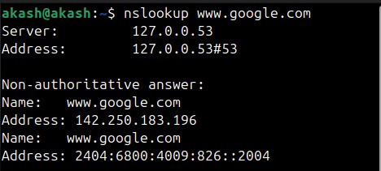
NETWORKING TRAINING - MODULE 7 & 8
Akash S, embedUR Systems
Qn 1:
Try Test-Connection and nslookup commands for below websites
www.google.com, www.facebook.com www.amazon.com, www.github.com, www.cisco.com
nslookup:
nslookup - Name Server Lookup
It is a command-line tool used to query Domain Name System (DNS) servers to obtain domain name or IP address mappings.
What does nslookup do?
Resolves a domain name to its corresponding IP address.
Queries specific DNS servers for domain information.
We can diagnose DNS related network issues.
How it works?
When we type a domain name, nslookup contacts the system’s DNS resolver.
DNS resolver queries appropriate DNS server to get IP address
If the queried server is non-authoritative, it forwards the request to the authoritative DNS server.
Finally the domain name and its mapped IP is shown

Slide 2
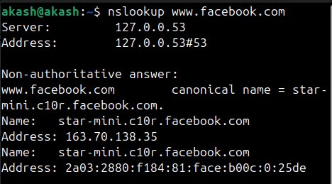
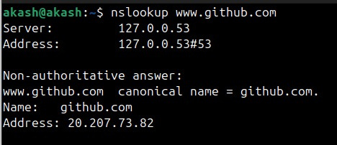
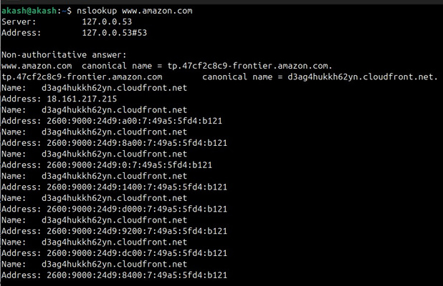
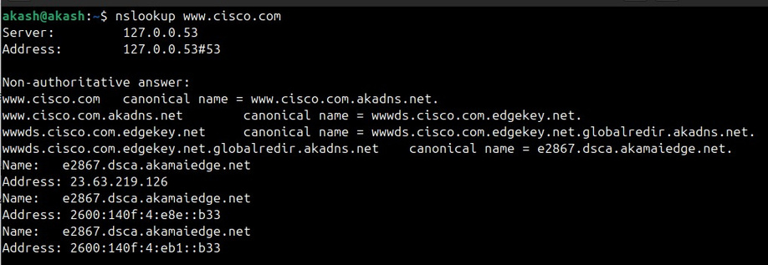

Slide 3

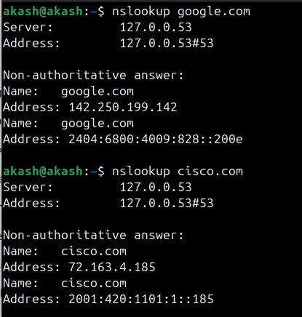
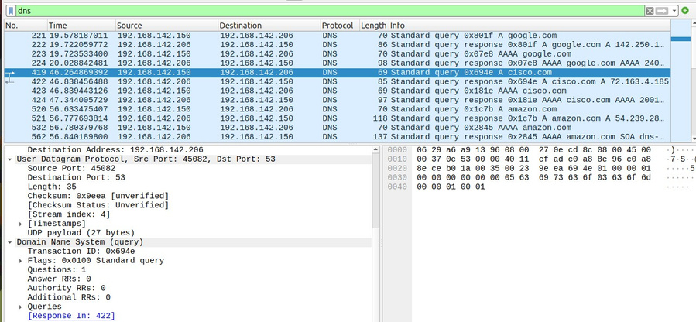
Qn 2:
. Use Wireshark to capture and analyze DNS, TCP, UDP traffic and packet header, packet flow, options and flags
Capturing DNS Traffic:
By running this command, we can capture DNS traffic
nslookup embedur.ai
In wireshark, we can filter the traffic with the keyword “dns”
google.com
cisco.com
dns traffic in wireshark

Slide 4

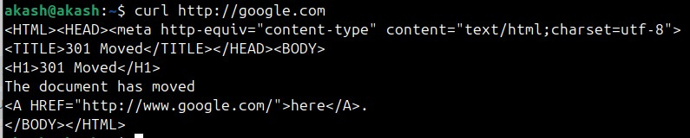
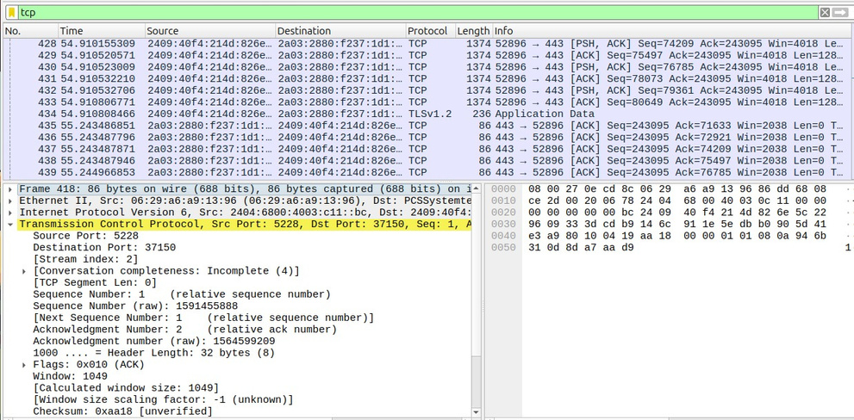
Capturing TCP Traffic:
By running this command, we can capture TCP traffic
curl http://embedur.ai
We can also capture tcp traffic by running any website in the machine
In wireshark, we can filter the traffic with the keyword “tcp”
curl command
tcp traffic in wireshark

Slide 5

Capturing UDP Traffic:
By running this command, we can capture TCP traffic
dig embedur.ai
In wireshark, we can filter the traffic with the keyword “udp”
dig command
udp traffic in wireshark

Slide 6


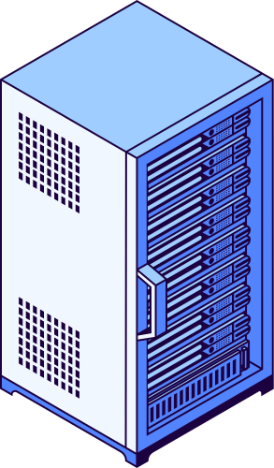

Qn 3:
Explore traceroute/tracert for different websites eg:google.com and analyse the parameters in the output and explore different options for traceroute command.
Traceroute:
Traceroute is a network diagnostic tool used to track the path that packets take from a source system to a destination across an IP network.
It helps identify network congestion, routing issues, and unreachable nodes.
How traceroute works:
While sending, the TTL value increases from 1
Upon reaching each and every router, the TTL value is decremented by 1
When TTL=0, packet is dropped
traceroute identifies time taken by each router to respond
Once target responds, full path is recorded
Options in traceroute:
-I : ICMP
-T : TCP
-p 23 : Destination Port number
-m 35 : Maximum hops needed
-w <time> : Timeout for each response
-4 : IPv4
-6 : IPv6

Slide 7
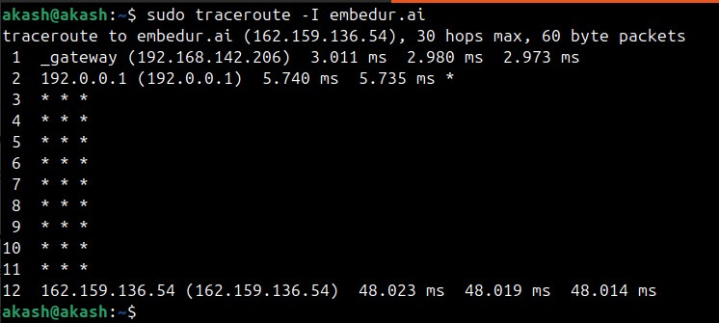
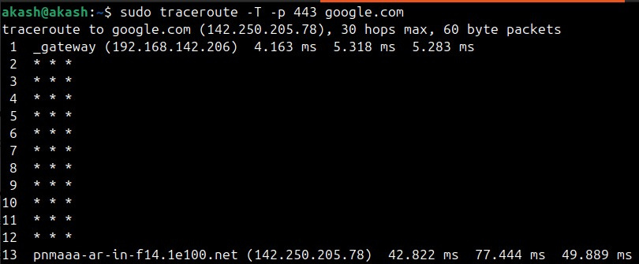
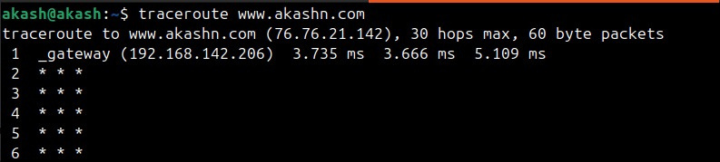
traceroute:

Slide 8
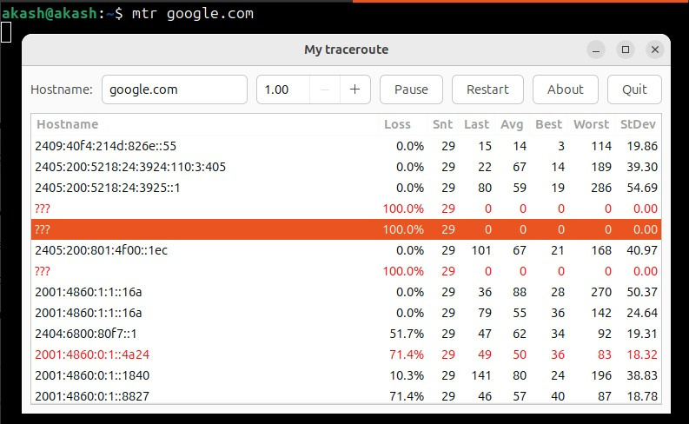
Detailed traceroute analysis using mtr:

Slide 9
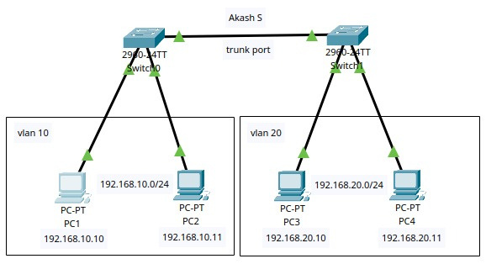
Qn 4 - 10:
Network Topology in Cisco Packet Tracer
VLAN, SSH/Telnet, Troubleshooting, Inter VLAN Routing
VLAN:
VLANs (Virtual Local Area Networks)
VLANs segment a network to separate traffic logically rather than physically.
Devices in the same VLAN can communicate, but different VLANs need a Layer 3 device (router or Layer 3 switch) for communication.
Trunk Port:
A trunk port is a switch port that carries multiple VLANs over a single physical link between network devices like switches or routers.
It uses 802.1Q encapsulation to tag VLAN traffic to differentiate different vlan when they travel across the trunk.

Slide 10

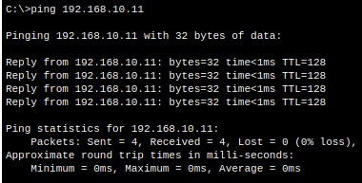

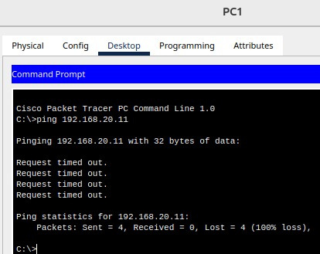
Pinging from PC1 to PC2:
There ‘s a problem!
Pinging works only inside the same vlan
When I pinged from PC 1 to PC2, it worked
When I pinged from PC3 to PC4, it worked
But when I pinged from PC1 to PC3 or PC4, it didn’t work

Slide 11
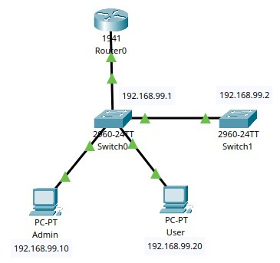
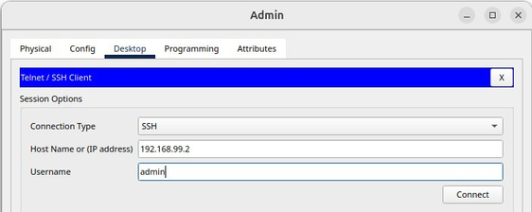
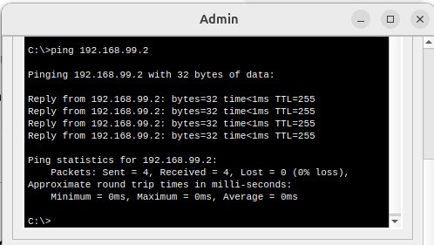
Testing SSH/Telnet:
I configured a network by connecting two PCs for remote access
PC1: 192.168.99.10
PC2: 192.168.99.20
I connected two switches and a router
When I tried connected to the host machine using ssh, it worked
ssh akash@192.168.99.2

Slide 12
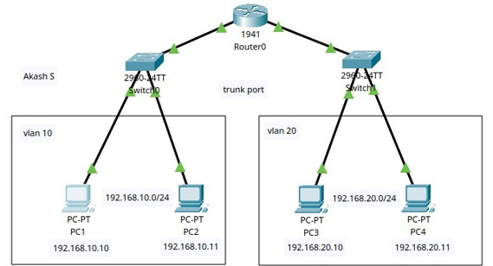
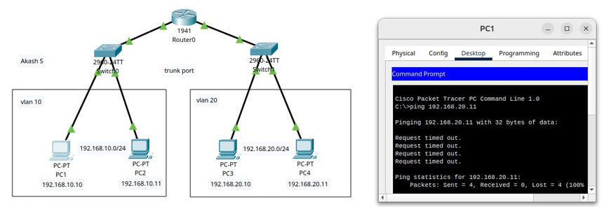
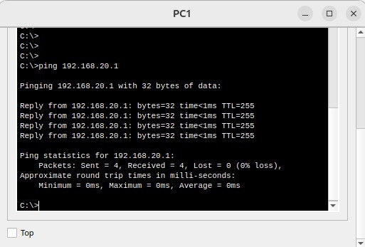
Troubleshooting Inter-VLAN pinging:
When I tried pinging from different VLAN to a different VLAN, it failed.
What could be the reason?
After several attempts, I realized that VLANs need routers to connect across different VLANs.
So I connected a router connecting two switches.

Slide 13
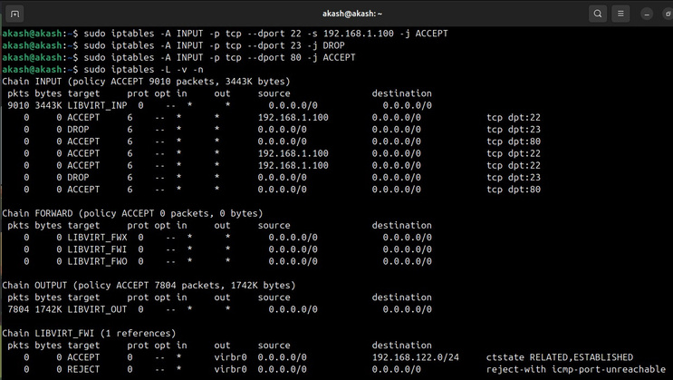
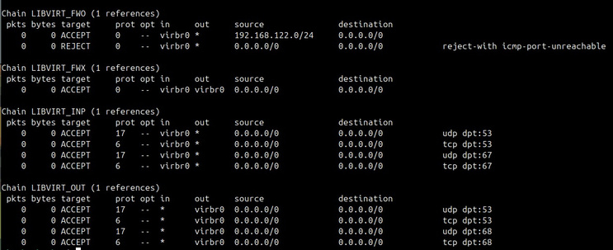
Qn 11:
Implement ACLs to restrict traffic based on source and destination ports. Test rules by simulating legitimate and unauthorized traffic.
ACL:
Access Control Lists are used to filter network traffic based on rules. They can control which packets are allowed or denied based on parameters such as source/destination IP addresses, protocols, and ports. This helps in enforcing security policies and managing traffic efficiently.
Steps I followed:
I created an extended ACL
I blocked SSH (port 22)
I allowed HTTP (port 80)
I also blocked ICMP ping requests to check how it works.

Slide 14
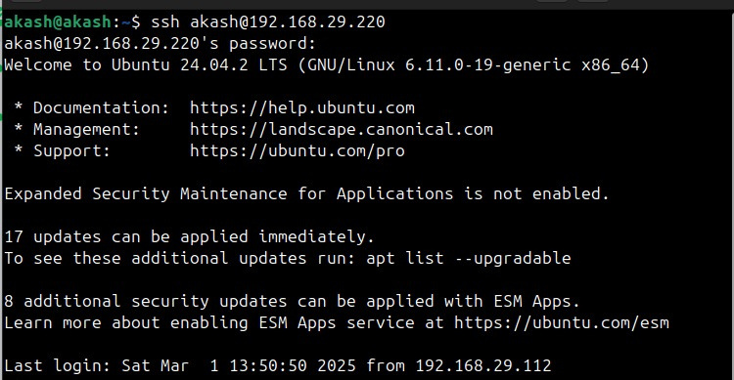
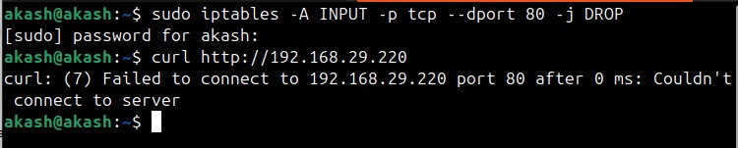
Testing how it works:
Two main commands:
ACCEPT: To allow the port
DROP: To block the port
Takeaway:
The above captures explain how the access is denied or controlled based on the specific port or ip address
It is useful when we want to allow only limited IPs or Ports in an organization

Slide 15
Qn 12 & 13:
Configure a standard Access Control List (ACL) on a router to permit traffic from a specific IP range. Test connectivity to verify the ACL is working as intended.
Create an extended ACL to block specific applications, such as HTTP or FTP traffic. Test the ACL rules by attempting to access blocked services.
Permit IP Range in ACL:
Steps I followed:
I tried this task by setting a network topology in the Cisco Packet Tracer.
I decided to allow traffic only from 192.168.1.0/24 and block all other sources.
Since standard ACLs filter only based on source IP, I had to ensure correct placement.
Configuring ACL on router:
I used these commands,
access-list 10 permit 192.168.1.0 0.0.0.255
access-list 10 deny any
Applying ACL to interface:
These commands are used to apply ACL to interface
interface GigabitEthernet0/0
ip access-group 10 in
exit

Slide 16
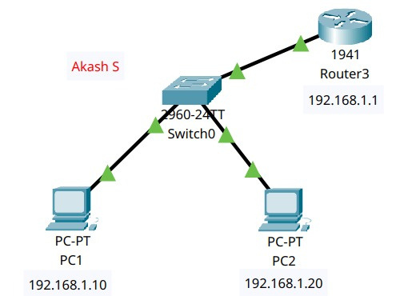
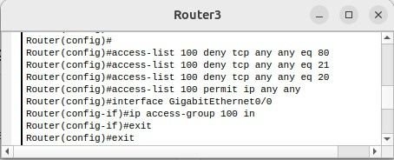
Testing:
A PC from the 192.168.1.0/24 range successfully accessed the router.
A PC from a different subnet was unable to connect.
Ping tests from an unauthorized subnet failed, confirming that the ACL was applied correctly.
Attempt 1:
I created a simple network to test first.
Added two PCs, a switch and a router.

Slide 17
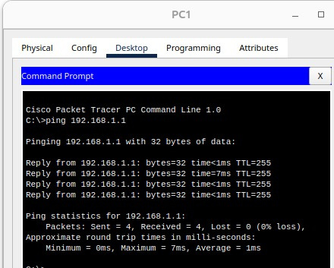
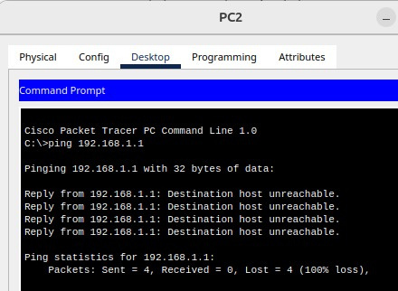
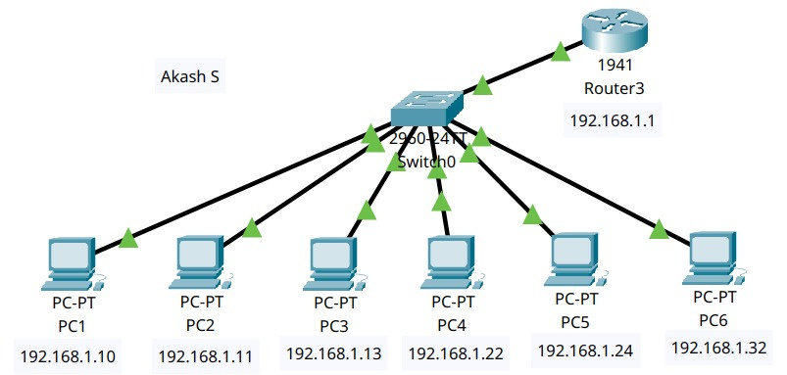
For testing purpose, I created a simple network to allow and check
Finally, the test network worked
So, implementing the actual network with multiple devices
Actual Network:
I constructed a network with 6 PCs, and I mentioned the network as /28 so it allowed the range 0-15
I used a wildcard mask to allow only first 15 and block the rest
I configured this on the router

Slide 18
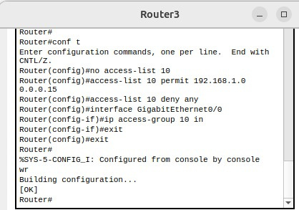
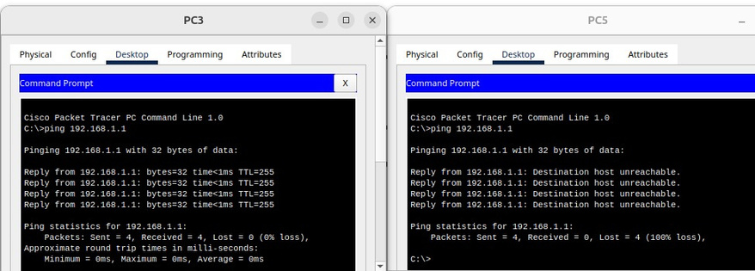
Router Configuration:
After masking with wildcard mask, the allowed and denied PCs are
PC1, PC2 & PC3 - range: 192.168.1.0 - 192.168.1.15
PC3 success!
PC5 failed!

Slide 19
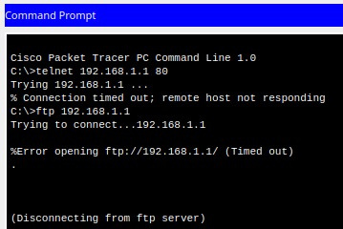
Permissions:
Allowing the HTTP Port:
access-list 100 deny tcp any any eq 80
Allowing the FTP Port - Data Transfer:
access-list 100 deny tcp any any eq 20
Allowing the FTP Port - Control Channel:
access-list 100 deny tcp any any eq 21
Router Configuration:
Results after updating the permission:

Slide 20
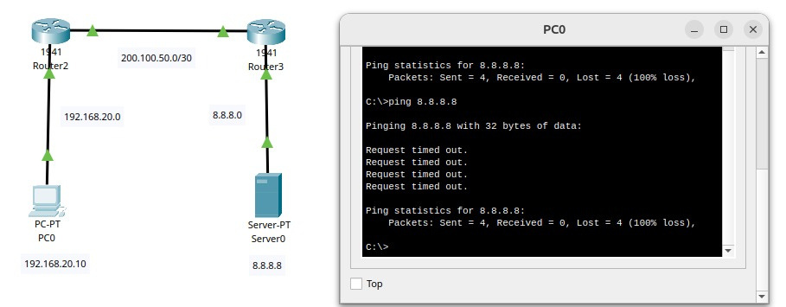
Qn 14:
Network Address Translation Task
NAT configuration:
I started by creating a small network with a PC, two routers and a server
Here are the IP configurations:
PC: 192.168.20.10
Server: 8.8.8.8
I allowed the routers to trunk
I configured NAT inside and NAT outside
Router inside IP:
PC - Router1: 192.168.20.1
Router1 - Router 2: 200.100.50.1
Router outside IP:
Router 1 - Router2: 200.100.50.2
Router2 - Server: 8.8.8.1
I tried several attempts to solve this and configured the final network.
I can’t access the server

Slide 21
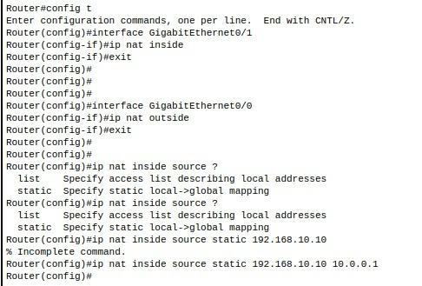
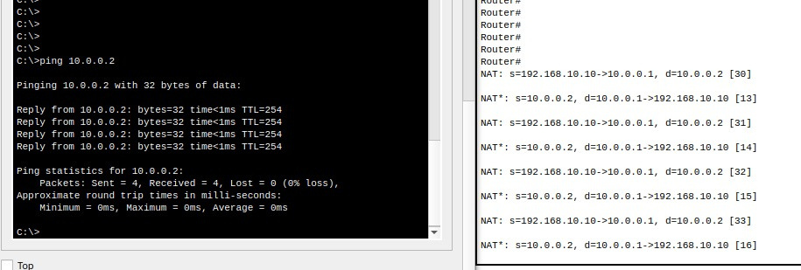
Actual Network:
There was a problem in between as I couldn’t reach Router 2 from PC1
I tried debugging through Router’s CLI and PC1's Command prompt
Configured
IP NAT Inside
IP NAT Outside
Router’s
CLI

Slide 22
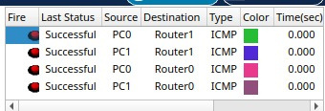
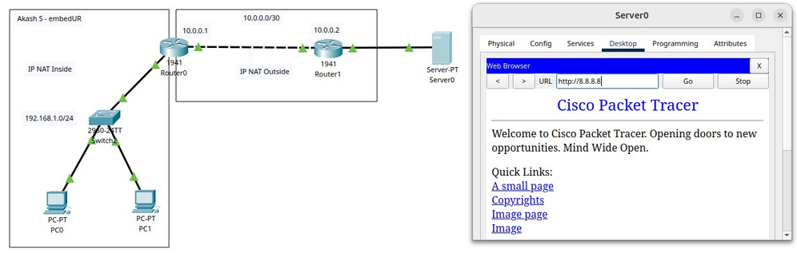

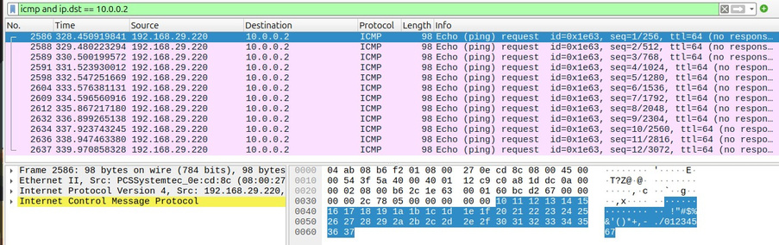
Results:
I can now connect to the Web Server
Google.com / 8.8.8.8

Slide 23
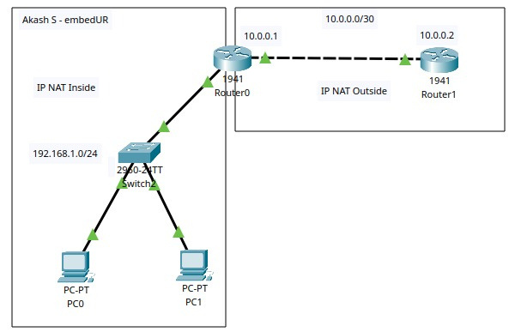
Network Topology:
NAT inside and NAT outside

Slide 24
Qn 15:
Download iperf in laptop/phone and make sure they are in same network. Try different iperf commands with tcp, udp, birectional, reverse, multicast, parallel options and analyze the bandwidth and rate of transmission, delay, jitter etc
iperf:
Iperf is a network performance testing tool that measures bandwidth, latency, jitter, and packet loss for TCP and UDP connections. It helps analyze network speed and performance under different conditions.
How iperf works?
iPerf works in a client-server model. One device runs as a server (listening for connections), while another acts as a client (sending data).
It supports TCP and UDP testing, bidirectional traffic, reverse mode, and parallel streams to simulate real-world network conditions.
In my case, I tested everything within VirtualBox using localhost (127.0.0.1) instead of two separate devices.
Commands I used:
Starting iperf3 server:
iperf3 -s
Running a TCP client mode:
iperf3 -c 127.0.0.1
Running a UDP server:
iperf3 -c 127.0.0.1 -u -b 10M

Slide 25
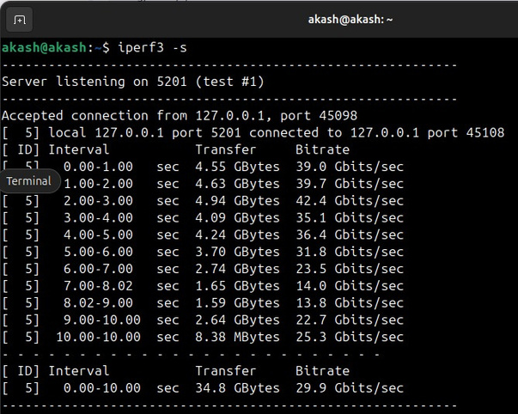
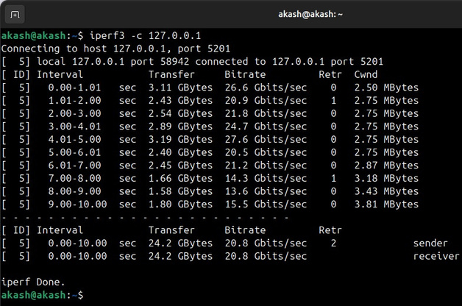
Bidirectional Test:
iperf3 -c 127.0.0.1 --bidir
Reverse Test:
iperf3 -c 127.0.0.1 -R
Parallel Streams Test:
iperf3 -c 127.0.0.1 -P 5
Results:
TCP Client

Slide 26
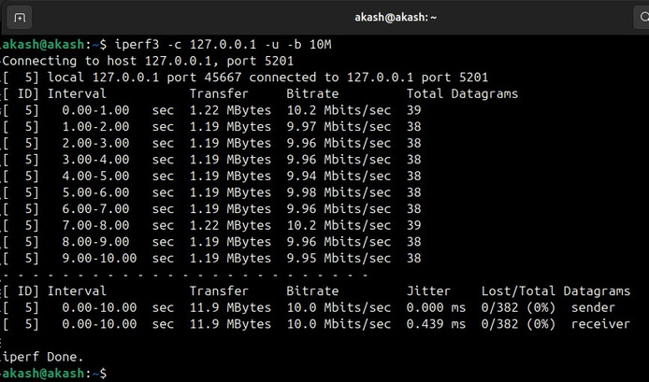
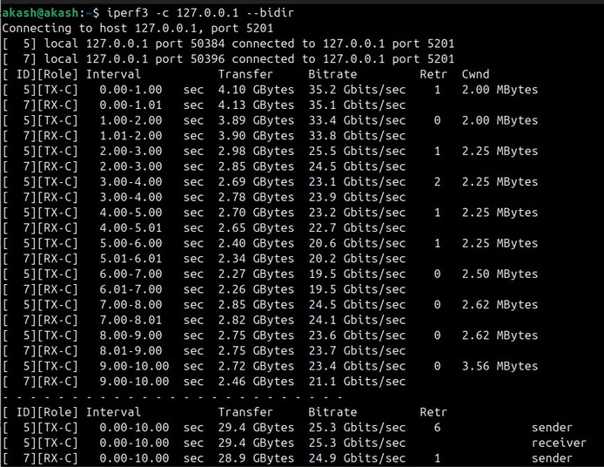
UDP Server:
Bidirectional:

Slide 27
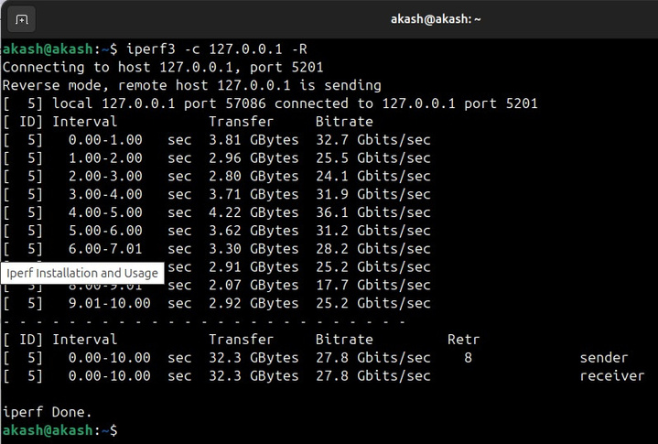
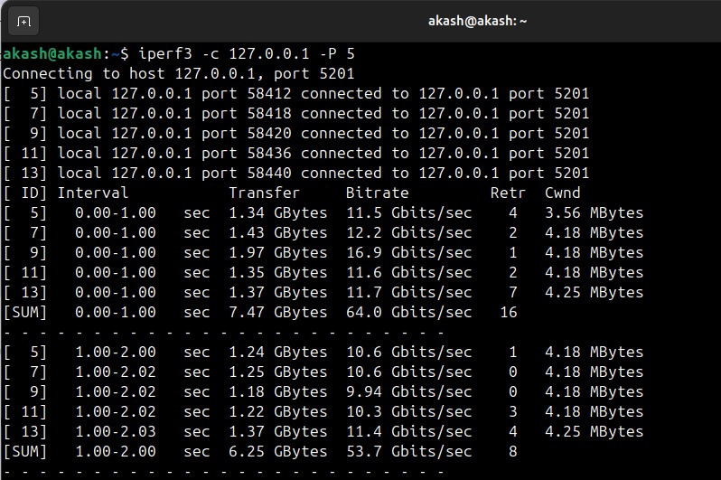
Reverse Test:
Parallel Stream Test:

Slide 28


THE END
AKASH S

